Slide 1
UPPER SIXTH ARTS
GEOGRAPHY
Lesson 11
Energy Resources
Notes:
Good morning, class, and welcome to our geography lesson. I am your geography teacher, Mr Kamdem. Today we are starting Lesson 11: Energy Resources.

Slide 2
CLASS INFO
Class, Chapter and Duration
Class | Upper Sixth Arts
Chapter | Module 6: Understanding and managing the dynamics of economic activities across the world in general and Cameroon in particular
Duration | 2 periods (2 × 50 minutes)
Notes:
This lesson is for Upper Sixth Arts. It belongs to Module 6: Understanding and managing the dynamics of economic activities across the world in general and Cameroon in particular. We shall need 2 periods to cover it.

Slide 3
IDENTIFICATION
Lesson Identification
Topic | Power Resources
Sub-topic | Power Resources
Lesson | Lesson 11: Energy Resources
Notions / Concepts | Energy, fossil fuel, renewable energy, hydro-electricity, energy conservation.
Syllabus focus | Definition and classification; sources and world distribution (producers and consumers); importance; problems (exhaustion, pollution); future energy sources; conservation.
Competence | Learners are able to classify energy resources, describe their distribution and propose sustainable solutions.
Notes:
Our topic is Power Resources, and the sub-topic is Power Resources. The key notions we shall use today are: energy, fossil fuel, renewable energy, hydro-electricity, energy conservation. At the end, you should be able to do this: learners are able to classify energy resources, describe their distribution and propose sustainable solutions.

Slide 4

HOMEWORK CORRECTION
Correction of the Homework
Question (Further Study 1: Agricultural Development and Change in Cameroon):
Draw the farming map of Cameroon and write one crop per region.
Notes:
Before we start the new lesson, let us correct the homework I gave you at the end of Further Study 1: Agricultural Development and Change in Cameroon. The question was: Draw the farming map of Cameroon and write one crop per region. Take out your exercise books.

Slide 5
HOMEWORK CORRECTION
Correction: Possible Answer
Map: cotton – North; cocoa – Centre, South, East; coffee – West and North-West; bananas and oil palm – Littoral and South-West; tea – South-West and North-West; cattle – Adamawa; rice – Far North (SEMRY).
Notes:
Here is a good answer. Map: cotton – North; cocoa – Centre, South, East; coffee – West and North-West; bananas and oil palm – Littoral and South-West; tea – South-West and North-West; cattle – Adamawa; rice – Far North (SEMRY). Compare it with your own answer and correct your work in red.

Slide 6
LESSON PLAN
Lesson Plan
Correction of the homework
Objectives and recall
Real-life situation and action to take
Learning activities
Board summary
Evaluation, remediation and homework
Notes:
Here is the plan of our lesson today. First, we shall correct the homework. Then we shall look at the objectives and recall what you already know. After that, we shall study a situation from real life and the action to take, and do the learning activities. Finally, we shall copy the board summary, do the evaluation and the remediation, and I will give you the homework.

Slide 7
OBJECTIVES
Objectives
By the end of this lesson, you should be able to:
Classify energy resources.
Describe world producers and consumers.
Explain problems of energy and future sources.
Notes:
By the end of this lesson, you should be able to do three things. Number 1: classify energy resources. Number 2: describe world producers and consumers. Number 3: explain problems of energy and future sources.

Slide 8
PREVIOUS KNOWLEDGE
Previous Knowledge
Oil and coal are non-renewable.
Rivers can produce electricity.
Notes:
Let us first remember what you already know. Oil and coal are non-renewable. Rivers can produce electricity. Keep this in mind, because we shall build on it today.

Slide 9
REAL-LIFE SITUATION
Situation in Real Life
Cameroon produces oil and hydro-electricity, yet many villages have no electricity and towns suffer power cuts. Meanwhile, the burning of oil and coal in the world changes the climate.
Notes:
Listen carefully to this situation from real life. Cameroon produces oil and hydro-electricity, yet many villages have no electricity and towns suffer power cuts. Meanwhile, the burning of oil and coal in the world changes the climate. Think about it, because I am going to ask you some questions.

Slide 10
REAL-LIFE SITUATION
Situation: Question 1
What is the problem in the situation?
Notes:
Question 1: What is the problem in the situation? Think for a moment, then raise your hand to answer.

Slide 11
REAL-LIFE SITUATION
Answer
Energy is unevenly available and some sources pollute.
Notes:
Good. Energy is unevenly available and some sources pollute.

Slide 12
REAL-LIFE SITUATION
Situation: Question 2
Which energy sources does Cameroon use?
Notes:
Question 2: Which energy sources does Cameroon use? Think for a moment, then raise your hand to answer.

Slide 13
REAL-LIFE SITUATION
Answer
Hydro-electricity, oil, gas and wood.
Notes:
Good. Hydro-electricity, oil, gas and wood.

Slide 14
REAL-LIFE SITUATION
Situation: Question 3
Which sources are clean?
Notes:
Question 3: Which sources are clean? Think for a moment, then raise your hand to answer.

Slide 15
REAL-LIFE SITUATION
Possible Answer
Renewable sources like hydro, solar and wind.
Notes:
Good. Renewable sources like hydro, solar and wind.

Slide 16
ACTION TO TAKE
Action to Take
Save energy and promote clean, renewable energy sources.
Notes:
From this situation, the action we are working towards in this lesson is the following: save energy and promote clean, renewable energy sources.

Slide 17
JUSTIFICATION
Justification of the Lesson
This lesson helps us to understand energy, a key resource for development.
Notes:
Why is this lesson important for you? This lesson helps us to understand energy, a key resource for development.

Slide 18
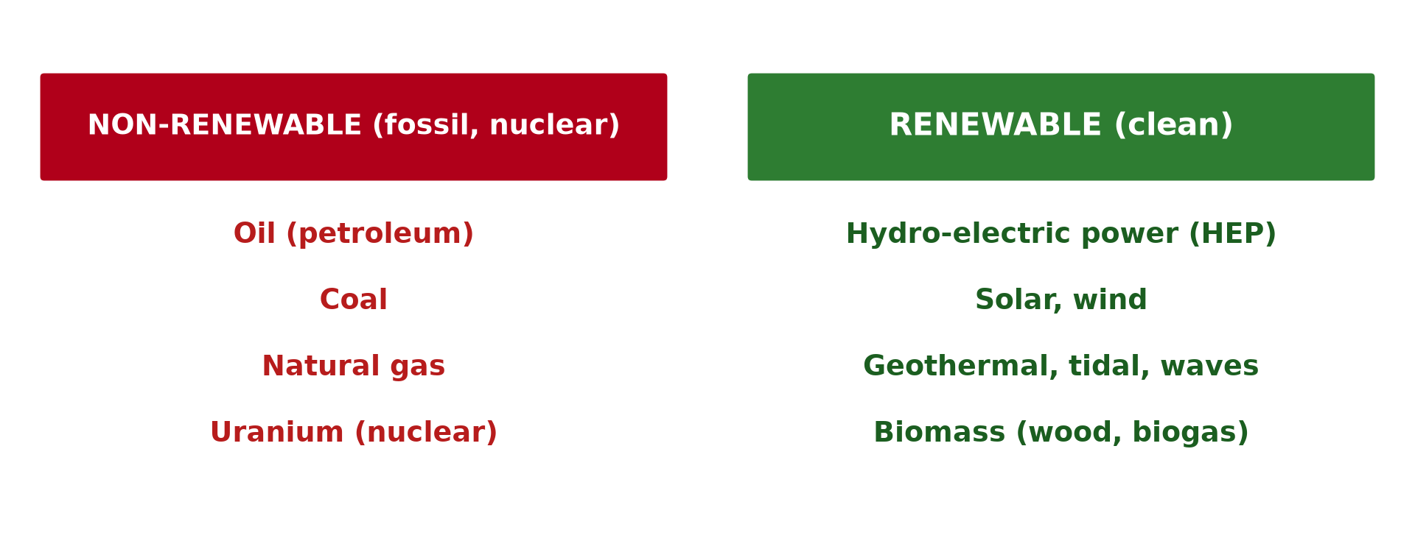
1. DEFINITION AND CLASSIFICATION
Activity 1
Renewable and non-renewable energy.
Notes:
Activity 1. Look carefully at this diagram: renewable and non-renewable energy. Observe every detail before I ask the question.

Slide 19
1. DEFINITION AND CLASSIFICATION
Activity 1: Question
Give two renewable and two non-renewable energy sources.
Notes:
Here is the question for Activity 1: Give two renewable and two non-renewable energy sources. Take one minute to think and write your answer in your rough notebook.

Slide 20
1. DEFINITION AND CLASSIFICATION
Activity 1: Answer
Renewable: solar, hydro. Non-renewable: oil, coal.
Notes:
Let us check the answer together. Renewable: solar, hydro. Non-renewable: oil, coal.

Slide 21
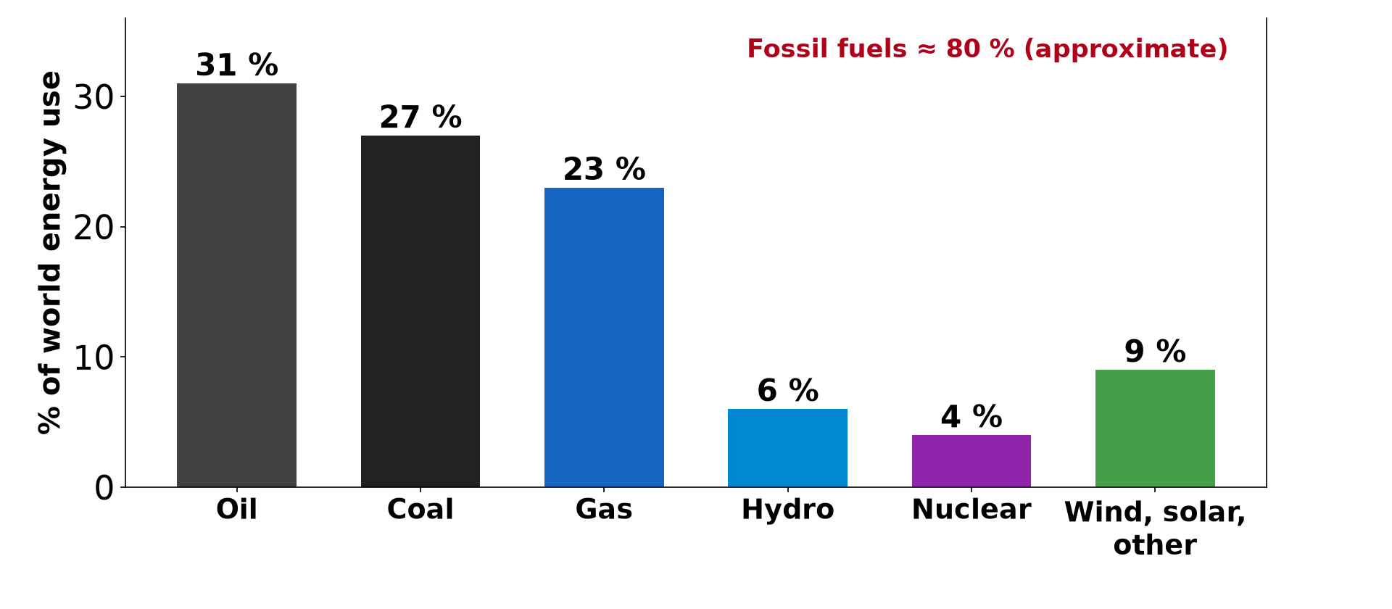
2. SOURCES AND DISTRIBUTION
Activity 2
World energy use by source (approximate).
Notes:
Activity 2. Look carefully at this diagram: world energy use by source (approximate). Observe every detail before I ask the question.

Slide 22
2. SOURCES AND DISTRIBUTION
Activity 2: Question
What share of world energy comes from fossil fuels?
Notes:
Here is the question for Activity 2: What share of world energy comes from fossil fuels? Take one minute to think and write your answer in your rough notebook.

Slide 23
2. SOURCES AND DISTRIBUTION
Activity 2: Answer
About 80 %.
Notes:
Let us check the answer together. About 80 %.

Slide 24
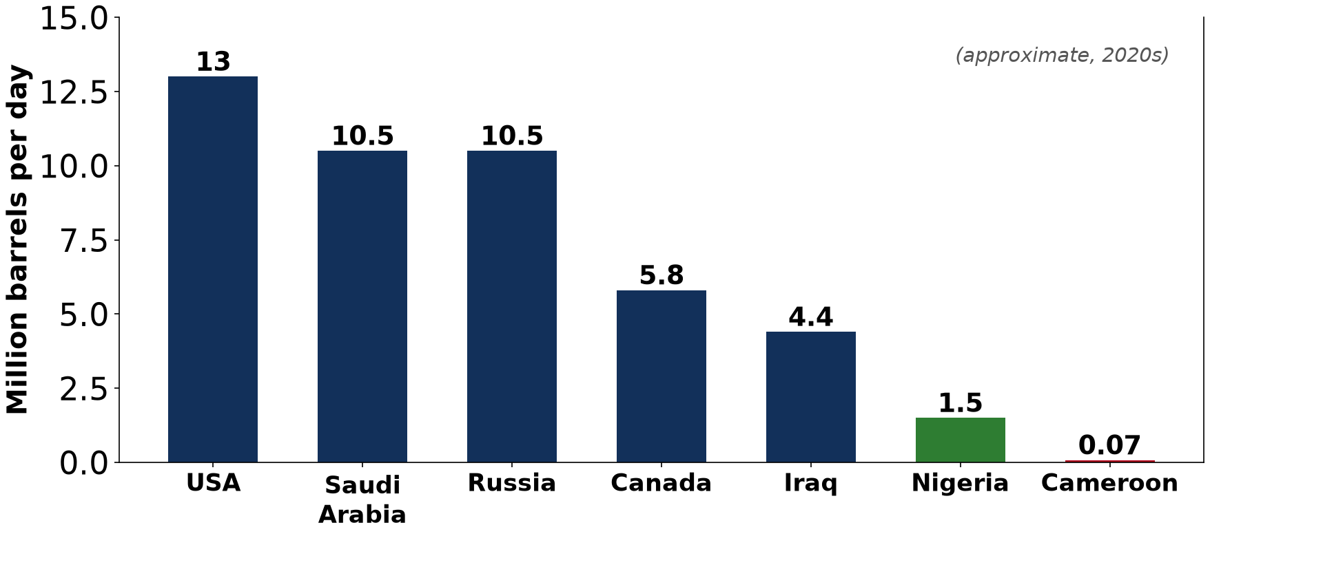
2. PRODUCERS AND CONSUMERS
Activity 3
Main oil producers (approximate).
Notes:
Activity 3. Look carefully at this diagram: main oil producers (approximate). Observe every detail before I ask the question.

Slide 25
2. PRODUCERS AND CONSUMERS
Activity 3: Question
Name the three largest oil producers.
Notes:
Here is the question for Activity 3: Name the three largest oil producers. Take one minute to think and write your answer in your rough notebook.

Slide 26
2. PRODUCERS AND CONSUMERS
Activity 3: Answer
USA, Saudi Arabia and Russia.
Notes:
Let us check the answer together. USA, Saudi Arabia and Russia.

Slide 27

4. PROBLEMS
Activity 4
An offshore oil platform.
Notes:
Activity 4. Look carefully at this picture: an offshore oil platform. Observe every detail before I ask the question.

Slide 28
4. PROBLEMS
Activity 4: Question
Give two problems of fossil fuels.
Notes:
Here is the question for Activity 4: Give two problems of fossil fuels. Take one minute to think and write your answer in your rough notebook.

Slide 29
4. PROBLEMS
Activity 4: Answer
They will run out and they pollute (greenhouse gases, oil spills).
Notes:
Let us check the answer together. They will run out and they pollute (greenhouse gases, oil spills).

Slide 30

5. ENERGY SOURCES FOR THE FUTURE
Activity 5
Solar panels.
Notes:
Activity 5. Look carefully at this picture: solar panels. Observe every detail before I ask the question.

Slide 31
5. ENERGY SOURCES FOR THE FUTURE
Activity 5: Question
Why are solar and wind called clean energy?
Notes:
Here is the question for Activity 5: Why are solar and wind called clean energy? Take one minute to think and write your answer in your rough notebook.

Slide 32
5. ENERGY SOURCES FOR THE FUTURE
Activity 5: Answer
They do not produce greenhouse gases and never run out.
Notes:
Let us check the answer together. They do not produce greenhouse gases and never run out.

Slide 33
BOARD SUMMARY
Board Summary
Topic: Power Resources
Sub-topic: Power Resources
Lesson 11: Energy Resources
Notes:
Now we are going to copy the board summary. Write the title and the headings neatly in your notebooks. I will give you enough time for each slide, so do not rush.

Slide 34
BOARD SUMMARY
1. Definition and Classification
Energy resources can be defined and classified as follows:
Energy resource: It is a source of power used to produce heat, light, movement and electricity.
Notes:
Let us copy Definition and Classification. Energy resources can be defined and classified as follows. On this slide we have Energy resource. Write each point on a new line, with the key term first, and explain it in your own words when we revise. When you finish, we go to the next slide.

Slide 35
BOARD SUMMARY
1. Definition and Classification (continued)
Non-renewable sources: They are fossil fuels (coal, oil, natural gas) and nuclear fuel (uranium). They will run out one day.
Renewable sources: They are hydro-electricity, solar, wind, geothermal, tidal and wave energy and biomass. They are renewed naturally.
Notes:
We continue with Definition and Classification. On this slide we have Non-renewable sources and Renewable sources. Write each point on a new line, with the key term first, and explain it in your own words when we revise.

Slide 36
BOARD SUMMARY
1. Definition and Classification
Illustration: classification of energy sources
Notes:
Now draw this illustration in your notebook: classification of energy sources. Give it a title and label it clearly.

Slide 37
BOARD SUMMARY
2. Sources, Distribution and Importance
Energy resources are distributed and used as follows:
Global distribution: Fossil fuels provide about 80 % of world energy. Oil is concentrated in the Middle East, Russia, the USA and parts of Africa (Nigeria, Angola).
Notes:
Let us copy Sources, Distribution and Importance. Energy resources are distributed and used as follows. On this slide we have Global distribution. Write each point on a new line, with the key term first, and explain it in your own words when we revise. When you finish, we go to the next slide.

Slide 38
BOARD SUMMARY
2. Sources, Distribution and Importance (continued)
Producers and consumers: The USA, Saudi Arabia and Russia are the largest oil producers. The USA, China and Europe are the largest consumers.
Notes:
We continue with Sources, Distribution and Importance. On this slide we have Producers and consumers. Write each point on a new line, with the key term first, and explain it in your own words when we revise. When you finish, we go to the next slide.

Slide 39
BOARD SUMMARY
2. Sources, Distribution and Importance (continued)
Importance: Energy powers industry, transport, homes and agriculture and is linked to development. Energy exports bring revenue to countries such as Cameroon.
Notes:
We continue with Sources, Distribution and Importance. On this slide we have Importance. Write each point on a new line, with the key term first, and explain it in your own words when we revise.

Slide 40
BOARD SUMMARY
2. Sources, Distribution and Importance
Illustration: main oil producers
Notes:
Now draw this illustration in your notebook: main oil producers. Give it a title and label it clearly.

Slide 41
BOARD SUMMARY
3. Problems, Future Sources and Conservation
Energy resources face the following problems and solutions:
Problems: Fossil fuels are exhaustible and their prices fluctuate. Their burning causes air pollution and climate change, and oil spills damage seas.
Notes:
Let us copy Problems, Future Sources and Conservation. Energy resources face the following problems and solutions. On this slide we have Problems. Write each point on a new line, with the key term first, and explain it in your own words when we revise. When you finish, we go to the next slide.

Slide 42
BOARD SUMMARY
3. Problems, Future Sources and Conservation (continued)
Energy sources for the future: HEP, solar, wind, wave and tidal, geothermal and biomass are clean and renewable. Cameroon has huge hydro potential and strong sunshine in the North.
Notes:
We continue with Problems, Future Sources and Conservation. On this slide we have Energy sources for the future. Write each point on a new line, with the key term first, and explain it in your own words when we revise. When you finish, we go to the next slide.

Slide 43
BOARD SUMMARY
3. Problems, Future Sources and Conservation (continued)
Energy conservation: Efficient lamps and machines, insulation, public transport and recycling reduce energy use. Saving energy also saves money.
Notes:
We continue with Problems, Future Sources and Conservation. On this slide we have Energy conservation. Write each point on a new line, with the key term first, and explain it in your own words when we revise.

Slide 44
FORMATIVE EVALUATION
Evaluation 1
Classify energy resources with two examples each.
Notes:
Now let us check what you have understood. Question 1: Classify energy resources with two examples each. Answer in your exercise book.

Slide 45
FORMATIVE EVALUATION
Expected Answer
Non-renewable: oil, coal. Renewable: hydro, solar.
Notes:
The expected answer is: non-renewable: oil, coal. Renewable: hydro, solar. If you got it right, well done.

Slide 46
FORMATIVE EVALUATION
Evaluation 2
Give two problems of fossil fuels and two solutions.
Notes:
Now let us check what you have understood. Question 2: Give two problems of fossil fuels and two solutions. Answer in your exercise book.

Slide 47
FORMATIVE EVALUATION
Expected Answer
Problems: exhaustion, pollution. Solutions: renewable energy, conservation.
Notes:
The expected answer is: problems: exhaustion, pollution. Solutions: renewable energy, conservation. If you got it right, well done.

Slide 48
REMEDIATION
Remediation
Fill in the blanks:
Coal, oil and gas are ______ fuels.
Energy from rivers is ______.
Using less energy is energy ______.
Notes:
For those who need more practice, fill in the blanks in your exercise book. The answers are: number 1, fossil; number 2, hydro-electricity; number 3, conservation.

Slide 49
HOMEWORK
Homework
List the energy sources used in your home and suggest how to save energy.
Notes:
For your homework: List the energy sources used in your home and suggest how to save energy. We shall correct it at the beginning of our next lesson.

Slide 50
NEXT LESSON
Next Lesson
Our next lesson will be on:
Lesson 13: Minerals and Mining
Notes:
Our next lesson will be on Lesson 13: Minerals and Mining. Thank you for your attention, and see you next time.

Slide 51
BILINGUAL GAME
Bilingual Game (Jeu Bilingue)
English | Français
Energy | L'énergie
Fossil fuel | Le combustible fossile
Solar energy | L'énergie solaire
Wind | Le vent
Power cut | La coupure de courant
Conservation | Les économies d'énergie
Notes:
Let us play the bilingual game. I say a word in English, and you give me the French word. Then we do the reverse.

Slide 52
LOGBOOK
Official Logbook (1/2)
Module / Topic | Power Resources
Lesson Title | Lesson 11: Energy Resources
Expected Learning Outcomes | Classify energy resources. Describe world producers and consumers. Explain problems of energy and future sources.
Competence | Learners are able to classify energy resources, describe their distribution and propose sustainable solutions.
Notes:
I record this information in the official logbook of the class after the lesson.

Slide 53
LOGBOOK
Official Logbook (2/2)
Matter Taught | Definition and Classification; Sources, Distribution and Importance; Problems, Future Sources and Conservation.
Evaluation | Formative evaluation and remediation exercise.
Homework | List the energy sources used in your home and suggest how to save energy.
Enrolment / Present / Absent | ____ / ____ / ____
Achievement | To be completed after the lesson.
Notes:
I complete the second page of the logbook: the matter taught, the evaluation, the homework and the attendance.

Slide 54
TEACHER'S NOTE
Teacher's Note
Timing: Homework correction, plan, objectives 8 min | Recall, situation, action 10 min | 5 activities 30 min | Board summary (copying) 30 min | Evaluation, remediation 10 min | Homework, next lesson 5 min | Logbook 7 min
Without the projector (Activity 1): sort energy sources.
Without the projector (Activity 2): read the bars.
Without the projector (Activity 3): find them on a map.
Without the projector (Activity 4): discuss pollution.
Without the projector (Activity 5): discuss solar in villages.
Notes:
This slide is for me, the teacher: it gives the timing of the lesson and what to do if the projector is not available.

Slide 55
REFERENCES
References
National Geography Syllabus, MINESEC/IGE/IP-SS, 2019 — Module 6 (Economic Geography).
Photo, Activity 4: “Rig I” by Tuftronic10000, CC BY 2.0, via Flickr (https://www.flickr.com/photos/36574363@N00/367931994)
Photo, Activity 5: “Noor Ouarzazate III Solar Plant” by Richard Allaway, CC BY 2.0, via Flickr (https://www.flickr.com/photos/16287002@N00/52769922684)
Diagrams and animations: drawn for this lesson (Geography Department).
Notes:
These are the references and picture credits used to prepare this lesson.

